Slide 1
Online Chess Engine Comparator
Orion Gregory, Sebastian Shirk, Tejas Bhadoria
Sprint 1
GitHub: https://github.com/OrionGregory/ChessEngineComparator

Slide 2
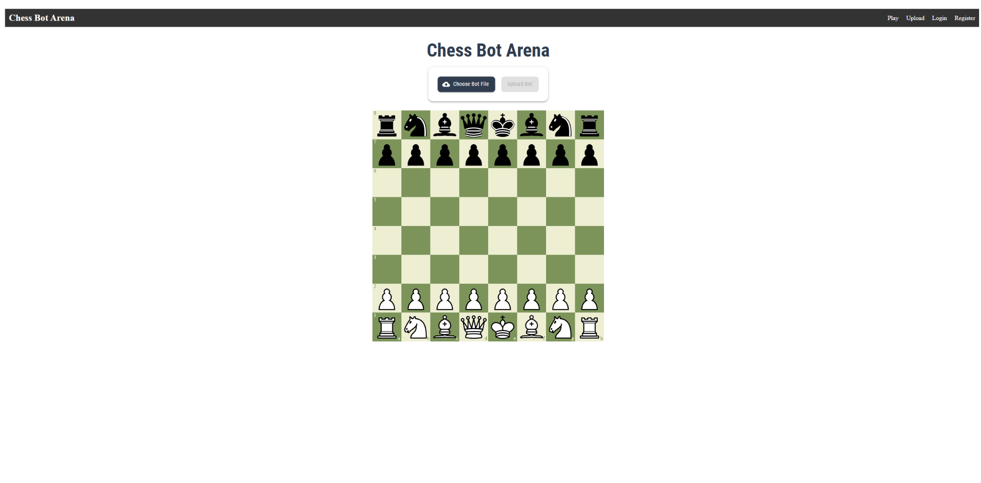
Project Overview
Create a web app where users can upload chess bots and test them against other user uploaded chess bots.
Provide an interactive interface for users to watch chess matches between bots unfold in real time
Offer real time feedback of the moves the bot is making as well as a general indication of which bot is winning.
Provide optimal move suggestions for comparison.

Slide 3
Sprint Goals
Create the basic framework for our webapp.
Create a chess bot in python to use for testing.
Allow ourselves to upload and play against the chess bot. This will later be replaced with bot vs. bot.
Visualize the chessboard and gameplay with Chessboard.js
Move History panel, so users can see all moves throughout game

Slide 4
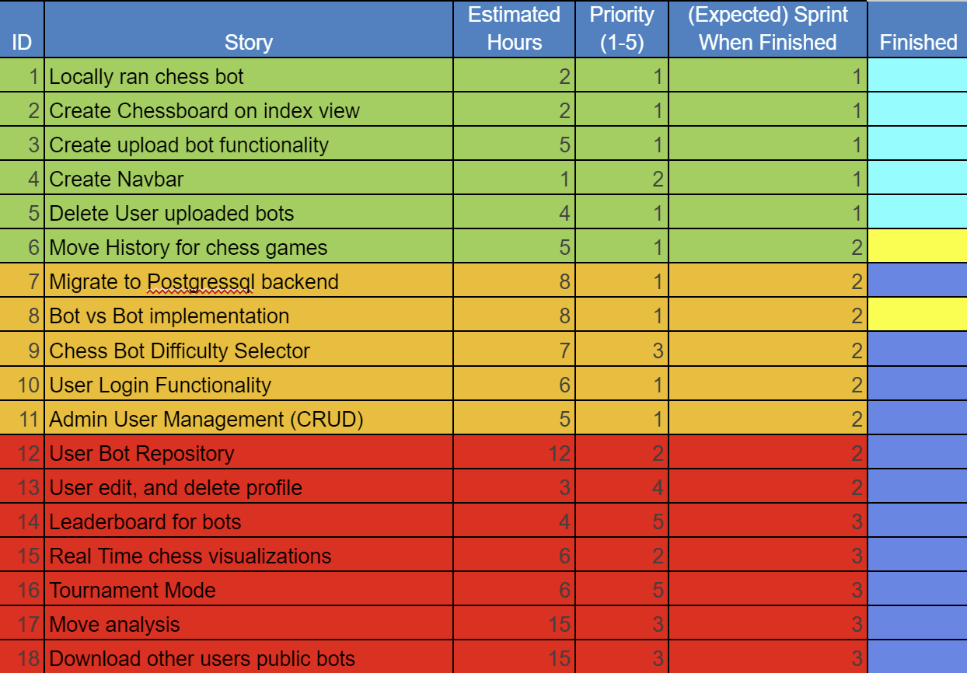
Sprint Backlog
Cyan - Finished Yellow - In Progress Blue - To Be Done

Slide 5
Sprint Reflection
What went well:
Frontend/backend implementation
Chess bot creation
Chess board visualization
What didn’t go well:
Chess Bot Difficulty Slider implementation
Move History table
What could be improved:
Website will need many improvements such as visuals, structure, and functionality.
Need to actually store bots which includes creating users and a login system.
Challenges:
Ensuring a consistent environment across everyone's machines
Getting familiar with React and Flask

Slide 6
Sprint Reflection
Orion Gregory:
Wrote the chess bots/ Implemented Stockfish
Created chess game logic with FEN input/output
React containers for chessboard and upload functionality
Sebastian Shirk:
Start up backend to hold, upload, and play against a chess bot.
NavBar addition to frontend (Play, Upload, Login, Register)
Tejas Bhadoria:
Start up frontend.
Use Chessboard.js to visualize the game.
Update code to handle two chess bots playing against each other.

Slide 7
Demo Time

